Slide 1
Critical Path Method

Slide 2
Example 1- A simple network
Consider the list of four activities for making a simple product:
Activity Description Immediate
predecessors
A Buy Plastic Body -
B Design Component -
C Make Component B
D Assemble product A,C
Immediate predecessors for a particular activity are the activities that, when completed, enable the start of the activity in question.

Slide 3
Sequence of activities
Can start work on activities A and B anytime, since neither of these activities depends upon the completion of prior activities.
Activity C cannot be started until activity B has been completed
Activity D cannot be started until both activities A and C have been completed.
The graphical representation (next slide) is referred to as the PERT/CPM network

Slide 4
Network of Four Activities
Arcs indicate project activities
A
D
1
3
4
B
C
2
Nodes correspond to the beginning and ending of activities

Slide 5
Example 2
Develop the network for a project with following activities and immediate predecessors:
Activity Immediate
predecessors
A -
B -
C B
D A, C
E C
F C
G D,E,F
Try to do for the first five (A,B,C,D,E) activities

Slide 6
Network of first five activities
A
D
1
3
4
E
B
C
5
2
We need to introduce a dummy activity

Slide 7
Network of Seven Activities
1
A
3
D
4
G
7
dummy
E
B
C
5
F
2
6
Note how the network correctly identifies D, E, and F as the immediate predecessors for activity G.
Dummy activities is used to identify precedence relationships correctly and to eliminate possible confusion of two or more activities having the same starting and ending nodes
Dummy activities have no resources (time, labor, machinery, etc) – purpose is to PRESERVE LOGIC of the network

Slide 8
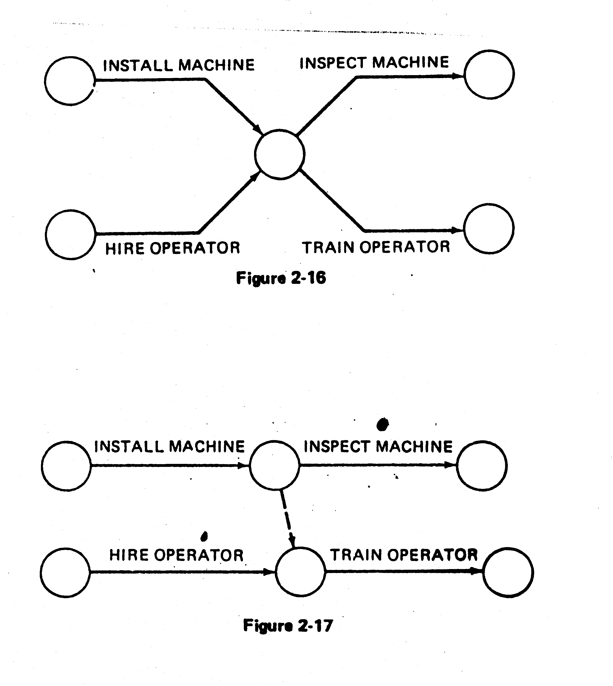
EXAMPLES OF THE USE OF DUMMYACTIVITY
Network concurrent activities
a
a
2
1
2
1
Dummy
b
b
3
WRONG!!!
RIGHT ✓
Activity c not required for e
WRONG !
a
a
d
e
1
b
1
e
b
c
d
2
c
WRONG!!!
RIGHT ✓
RIGHT ✓

Slide 9
WRONG!!!
RIGHT!!!
a
d
a
d
1
1
b
e
b
2
2
4
e
c
f
c
3
f
3
a precedes d.
a and b precede e,
b and c precede f (a does not precede f)

Slide 10
Scheduling with activity time
Activity Immediate Completion
predecessors Time (week)
A - 5
B - 6
C A 4
D A 3
E A 1
F E 4
G D,F 14
H B,C 12
I G,H 2
Total …… 51
This information indicates that the total time required to complete activities is 51 weeks. However, we can see from the network that several of the activities can be conducted simultaneously (A and B, for example).

Slide 11
Earliest start & earliest finish time
We are interested in the longest path through the network, i.e., the critical path.
Starting at the network’s origin (node 1) and using a starting time of 0, we compute an earliest start (ES) and earliest finish (EF) time for each activity in the network.
The expression EF = ES + t can be used to find the earliest finish time for a given activity.
For example, for activity A, ES = 0 and t = 5; thus the earliest finish time for activity A is
EF = 0 + 5 = 5

Slide 12
Arc with ES & EF time
EF = earliest finish time
ES = earliest start time
Activity
2
A [0,5]
5
1
t = expected activity
time

Slide 13
Network with ES & EF time
D[5,8]
3
5
2
F[6,10]
4
G[10,24]
14
A[0,5]
5
E[5,6]
1
7
C[5,9]
4
4
I[24,26]
2
1
6
B[0,6]
6
H[9,21]
12
3
Earliest start time rule:
The earliest start time for an activity leaving a particular node is equal to the largest of the earliest finish times for all activities entering the node.

Slide 14
Activity, duration, ES, EF, LS, LF
EF = earliest finish time
ES = earliest start time
Activity
3
C [5,9]
4 [8,12]
2
LF = latest finish time
LS = latest start time

Slide 15
Latest start & latest finish time
To find the critical path we need a backward pass calculation.
Starting at the completion point (node 7) and using a latest
finish time (LF) of 26 for activity I, we trace back through the
network computing a latest start (LS) and latest finish time
for each activity
The expression LS = LF – t can be used to calculate latest start
time for each activity. For example, for activity I, LF = 26 and t
= 2, thus the latest start time for activity I is
LS = 26 – 2 = 24

Slide 16
Network with LS & LF time
D[5,8]
3[7,10]
5
2
G[10,24] 14[10,24]
F[6,10]
4[6,10]
A[0,5]
5[0,5]
E[5,6]
1[5,6]
7
4
I[24,26]
2[24,26]
C[5,9]
4[8,12]
1
6
B[0,6]
6[6,12]
H[9,21]
12[12,24]
3
Latest finish time rule:
The latest finish time for an activity entering a particular node is equal to the smallest of the latest start times for all activities leaving the node.

Slide 17
Slack or Free Time or Float
Slack is the length of time an activity can be delayed without affecting the completion date for the entire project.
For example, slack for C = 3 weeks, i.e Activity C can be delayed up to 3 weeks
(start anywhere between weeks 5 and 8).
3
C [5,9]
4 [8,12]
2
ES
5
LS
8
EF
9
EF
12
LF-EF = 12 –9 =3
LS-ES = 8 – 5 = 3
LF-ES-t = 12-5-4 = 3

Slide 18
Terms Used in Project Management
Activity : A certain amount of work or task required in the project
Activity duration: In CPM the best estimate of time to complete an activity . In PERT the expected time or average time to complete an activity
Critical activity : An activity that has no room for schedule slippages : if it slips the entire the entire project completion will slip. An activity with zero slack

Slide 19
Terms Used in Project Management .cont
Critical path: The chain of critical activities for the project .The longest path through the network
Dummy activity :An activity that consumes no time but shows precedence among activities
Earliest finish (EF): The earliest that an activity can finish from the beginning of the project
Earliest start ( ES): The earliest that an activity can start from the beginning of the project

Slide 20
Terms Used in Project Management .cont
Event :A beginning , a completion point ,or a milestone accomplishment within the project . An activity begins and ends with events
Latest finish (LF) : The latest that an activity can finish from the beginning of the project
Latest start (LS) :The latest that an activity can start from the beginning of the project

Slide 21
Terms Used in Project Management .cont
Predecessor activity : An activity that must occur before another activity .
Slack : The amount of time that an activity or group of activities can slip without causing a delay in the completion of the project
Successor activity : An activity that must occur after another activity

Slide 22
Terms Used in Project Management .cont
Conventions used in drawing network diagrams (Arrows & Circles )
Activity on Arrow (AOA) : The activities are denoted by Arrows and events are denoted by circles
Activity on Node(AON) : Activities are denoted by circles(or nodes) and the precedence relation ships between activities are indicated by arrows

Slide 23
St. Paul’s Hospital
Immediate
Activity Description Predecessor(s)
A Select administrative and medical staff.
B Select site and do site survey.
C Select equipment.
D Prepare final construction plans and layout.
E Bring utilities to the site.
F Interview applicants and fill positions in nursing,
support staff, maintenance, and security.
G Purchase and take delivery of equipment.
H Construct the hospital.
I Develop an information system.
J Install the equipment.
K Train nurses and support staff.
—
—
A
B
B
A
C
D
A
E,G,H
F,I,J

Slide 24
St. Paul’s Hospital
AON Network
Immediate
Activity Description Predecessor(s)
I
A Select administrative and medical staff.
B Select site and do site survey.
C Select equipment.
D Prepare final construction plans and layout.
E Bring utilities to the site.
F Interview applicants and fill positions in nursing,
support staff, maintenance, and security.
G Purchase and take delivery of equipment.
H Construct the hospital.
I Develop an information system.
J Install the equipment.
K Train nurses and support staff.
A
F
K
—
—
A
B
B
A
C
D
A
E,G,H
F,I,J
Start
C
G
Finish
B
D
H
J
E

Slide 25
St. Paul’s Hospital
Immediate
Activity Description Predecessor(s)
Completion Time
I
15
A Select administrative and medical staff.
B Select site and do site survey.
C Select equipment.
D Prepare final construction plans and layout.
E Bring utilities to the site.
F Interview applicants and fill positions in nursing,
support staff, maintenance, and security.
G Purchase and take delivery of equipment.
H Construct the hospital.
I Develop an information system.
J Install the equipment.
K Train nurses and support staff.
—
—
A
B
B
A
C
D
A
E,G,H
F,I,J
A
12
F
10
K
9
Start
C
10
G
35
Finish
B
9
D
10
H
40
J
4
E
24

Slide 26
St. Paul’s Hospital
Path Expected Time (wks)
A-I-K 36
A-F-K 31
A-C-G-J-K 70
B-D-H-J-K 72
B-E-J-K 46
Critical Path
Immediate
Activity Description Predecessor(s)
Completion Time
I
15
A Select administrative and medical staff.
B Select site and do site survey.
C Select equipment.
D Prepare final construction plans and layout.
E Bring utilities to the site.
F Interview applicants and fill positions in nursing,
support staff, maintenance, and security.
G Purchase and take delivery of equipment.
H Construct the hospital.
I Develop an information system.
J Install the equipment.
K Train nurses and support staff.
—
—
A
B
B
A
C
D
A
E,G,H
F,I,J
A
12
F
10
K
9
Start
C
10
G
35
Finish
B
9
D
10
H
40
J
4
E
24

Slide 27
Critical Path
The longest path in the network
Defines the shortest time project can be completed
Critical path activity delay project delay

Slide 28
Earliest Start and Earliest Finish
Begin at starting event and work forward
ES is earliest start
ES = 0 for starting activities
ES = Maximum EF of all predecessors for non-starting activities
EF is earliest finish
EF = ES + Activity time
Activity Name
ES
EF
LS
LF
Activity Duration

Slide 29
Earliest Start / Earliest Finish
I
15
A
12
F
10
K
9
C
10
G
35
Start
Finish
B
9
D
10
H
40
J
4
E
24

Slide 30
Earliest Start / Earliest Finish
I
15
12 27
Earliest start time
Earliest finish time
A
12
F
10
K
9
0 12
12 22
63 72
C
10
G
35
Start
12 22
22 57
Finish
Critical path
B
9
D
10
H
40
J
4
0 9
9 19
19 59
59 63
E
24
9 33

Slide 31
Latest Start and Latest Finish
Begin at ending event and work backward
LF is latest finish
LF = Maximum EF for ending activities
LF = Minimum LS of all successors for non-ending activities
LS is latest start
LS = LF – Activity time
Activity Name
ES
EF
LS
LF
Activity Duration

Slide 32
Latest Start / Latest Finish
I
15
12 27
Latest start time
48 63
Latest finish time
A
12
F
10
K
9
0 12
12 22
63 72
2 14
53 63
63 72
C
10
G
35
Start
12 22
22 57
Finish
Critical path
14 24
24 59
B
9
D
10
H
40
J
4
0 9
9 19
19 59
59 63
0 9
9 19
19 59
59 63
What do you notice about ES/LS & EF/LF?
E
24
9 33
35 59

Slide 33
Activity Slack Analysis
I
15
12 27
Slack = LS – ES
or
Slack = LF – EF
48 63
Latest start time
Latest finish time
A
12
F
10
K
9
0 12
12 22
63 72
2 14
53 63
63 72
C
10
G
35
Start
12 22
22 57
Finish
Slack_{K} = 63 – 63 = 0
or
Slack_{K} = 72 – 72 = 0
24 59
Critical path
14 24
B
9
D
10
H
40
J
4
0 9
9 19
19 59
59 63
0 9
9 19
19 59
59 63
E
24
9 33
35 59

Slide 34
Activity Slack Analysis
I
15
12 27
Node Duration ES LS Slack
A 12 0 2 2
B 9 0 0 0
C 10 12 14 2
D 10 9 9 0
E 24 9 35 26
F 10 12 53 41
G 35 22 24 2
H 40 19 19 0
I 15 12 48 36
J 4 59 59 0
K 6 63 63 0
Latest start time
48 63
Latest finish time
A
12
F
10
K
9
0 12
12 22
63 72
2 14
53 63
63 72
C
10
G
35
Start
12 22
22 57
Finish
Critical path
14 24
24 59
B
9
D
10
H
40
J
4
0 9
9 19
19 59
59 63
0 9
9 19
19 59
59 63
Activity slack = maximum delay time Critical path activities have zero slack
E
24
9 33
35 59

Slide 35
Activity Slack
How much would we like to reduce
the time for activity B?
B
20
5 25
5 25
A
5
D
10
Start
0 5
25 35
Finish
0 5
25 35
C
15
5 20
10 25

Slide 36
A critical path of the project is a path comprising of critical activities of the project.
It is to be remembered that
a project can have more than one critical path,
Any critical path will start at node 1 and will end at node n and that
The sum of the durations of the activities lying on a critical path is the duration of the project.

